Slide 1
Statistical Reasoning

Slide 2
Uncertain Knowledge
knowledge representation using first-order logic and propositional logic with certainty, which means we were sure about the predicates. With this knowledge representation, we might write A→B, which means if A is true then B is true, but consider a situation where we are not sure about whether A is true or not then we cannot express this statement, this situation is called uncertainty.
So to represent uncertain knowledge, where we are not sure about the predicates, we need uncertain reasoning or probabilistic reasoning.

Slide 3
Causes of uncertainty:
Information occurred from unreliable sources.
Experimental Errors
Equipment fault
Temperature variation
Climate change.

Slide 4
Probabilistic reasoning
Probabilistic : Probability to indicate the uncertainty in knowledge. In probabilistic reasoning, we combine probability theory with logic to handle the uncertainty.
In the real world, there are lots of scenarios, where the certainty of something is not confirmed, such as "It will rain today," "behavior of someone for some situations," "A match between two teams or two players." These are probable sentences for which we can assume that it will happen but not sure about it, so here we use probabilistic reasoning.

Slide 5
When there are unpredictable outcomes.
When specifications or possibilities of predicates becomes too large to handle.
When an unknown error occurs during an experiment.
Bayes' rule
Bayesian Statistics

Slide 6
Probability: Probability can be defined as a chance that an uncertain event will occur. It is the numerical measure of the likelihood that an event will occur. The value of probability always remains between 0 and 1 that represent ideal uncertainties.

Slide 7
Event: Each possible outcome of a variable is called an event.
Sample space: The collection of all possible events is called sample space.
Random variables: Random variables are used to represent the events and objects in the real world.
Prior probability: The prior probability of an event is probability computed before observing new information.
Posterior Probability: The probability that is calculated after all evidence or information has taken into account. It is a combination of prior probability and new information.

Slide 8
Following are some applications of Bayes' theorem:
It is used to calculate the next step of the robot when the already executed step is given.
Bayes' theorem is helpful in weather forecasting.

Slide 9

Conditional probability:
we want to calculate the event A when event B has already occurred, "the probability of A under the conditions of B", it can be written as:

Slide 10
In a class, there are 70% of the students who like English and 40% of the students who likes English and mathematics, and then what is the percent of students those who like English also like mathematics?

Slide 11

Bayes' theorem is also known as Bayes' rule, Bayes' law, or Bayesian reasoning, which determines the probability of an event with uncertain knowledge.
P(A|B) is known as posterior, which we need to calculate, and it will be read as Probability of hypothesis A when we have occurred an evidence B.
P(B|A) is called the likelihood, in which we consider that hypothesis is true, then we calculate the probability of evidence.
P(A) is called the prior probability, probability of hypothesis before considering the evidence
P(B) is called marginal probability, pure probability of an evidence.

Slide 12
A doctor is aware that disease meningitis causes a patient to have a stiff neck, and it occurs 80% of the time. He is also aware of some more facts, which are given as follows:
The Known probability that a patient has meningitis disease is 1/30,000.
The Known probability that a patient has a stiff neck is 2%.

Slide 13


Slide 14
From a standard deck of playing cards, a single card is drawn. The probability that the card is king is 4/52, then calculate posterior probability P(King|Face), which means the drawn face card is a king card.
P(king): probability that the card is King= 4/52= 1/13
P(face): probability that a card is a face card= 3/13
P(Face|King): probability of face card when we assume it is a king = 1

Slide 15
Three urns contain 6 red, 4 black; 4 red, 6 black, and 5 red, 5 black balls respectively. One of the urns is selected at random and a ball is drawn from it. If the ball drawn is red, find the probability that it is drawn from the first urn.
P(E1/A) = P(E1) P(A/E1)/P(E1) P(A/E1) + P(E2) P(A/E2) + P(E3) P(A/E3)

Slide 16
An insurance company insured 2000 scooter drivers, 4000 car drivers, and 6000 truck drivers. The probability of an accident involving a scooter driver, car driver, and a truck is 0.01, 0.03, and 0.015 respectively. One of the insured persons meets with an accident. What is the probability that he is a scooter driver?

Slide 17
Bayesian Belief Network in artificial intelligence
"A Bayesian network is a probabilistic graphical model which represents a set of variables and their conditional dependencies using a directed acyclic graph.“
Bayesian networks are probabilistic, because these networks are built from a probability distribution, and also use probability theory for prediction and anomaly detection.
Real world applications are probabilistic in nature, and to represent the relationship between multiple events, we need a Bayesian network. It can also be used in various tasks including prediction, anomaly detection, diagnostics, automated insight, reasoning, time series prediction, and decision making under uncertainty.

Slide 18
Bayesian Belief Network
Bayesian Network can be used for building models from data and experts opinions, and it consists of two parts:
Directed Acyclic Graph
Table of conditional probabilities.
The generalized form of Bayesian network that represents and solve decision problems under uncertain knowledge is known as an Influence diagram.

Slide 19
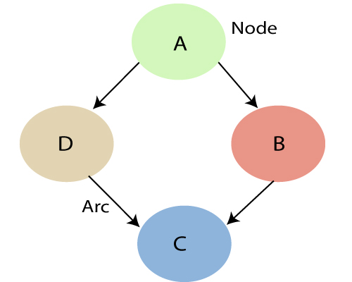
Bayesian Belief Network
The Bayesian network has mainly two components:
Causal Component
Actual numbers
Each node in the Bayesian network has condition probability distribution P(X_{i} |Parent(X_{i}) ), which determines the effect of the parent on that node.
Bayesian network is based on Joint probability distribution and conditional probability. So let's first understand the joint probability distribution:

Slide 20
Example
Harry installed a new burglar alarm at his home to detect burglary. The alarm reliably responds at detecting a burglary but also responds for minor earthquakes.
Harry has two neighbors john and Mary, who have taken a responsibility to inform Harry at work when they hear the alarm.
John always calls Harry when he hears the alarm, but sometimes he got confused with the phone ringing and calls at that time too.
On the other hand, Mary likes to listen to high music, so sometimes she misses to hear the alarm. Here we would like to compute the probability of Burglary Alarm.

Slide 21
Bayesian Belief Network
Calculate the probability of John calls.
Calculate the probability that alarm has sounded, but there is neither a burglary, nor an earthquake occurred, and David and Sophia both called the Harry.

Slide 22






































Slide 23
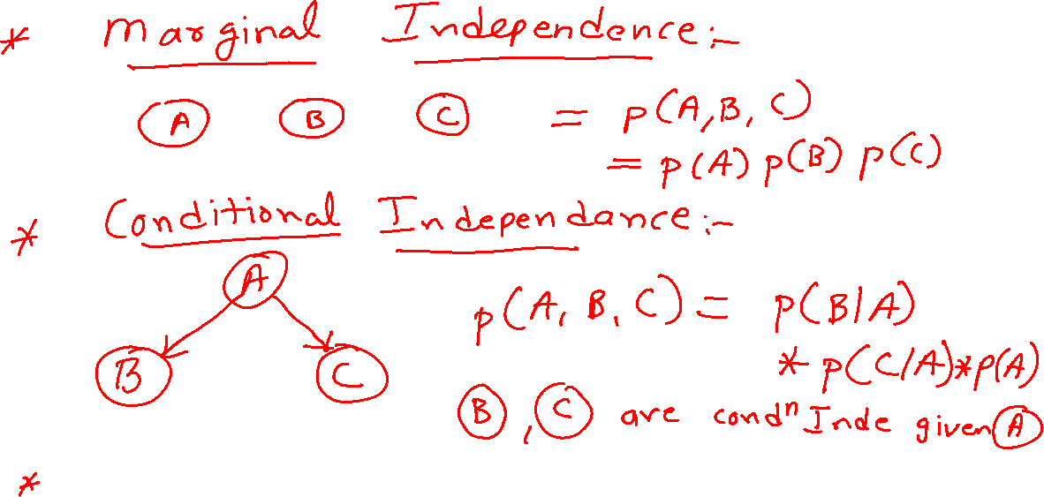

Slide 24





































Slide 25
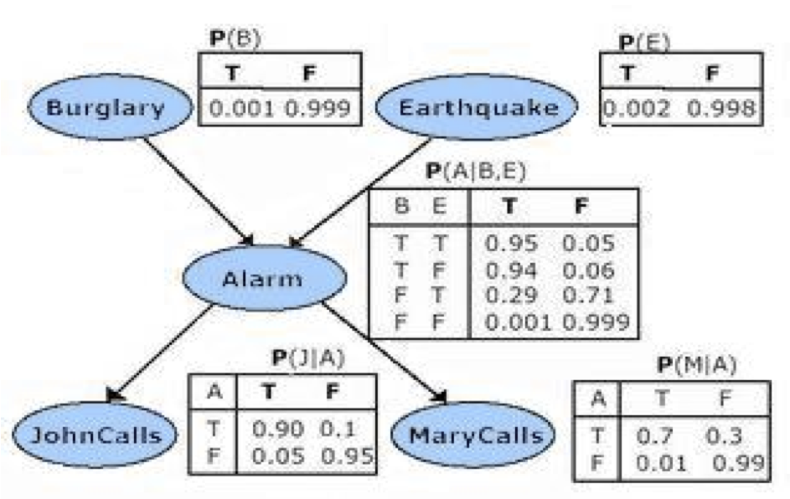

Slide 26















Bayesian Belief Network
Calculate the probability of John calls.

Slide 27



































Slide 28























Calculate the probability that alarm has sounded, but there is neither a burglary, nor an earthquake occurred, and john and mary both called the Harry.

